Slide 1
Down's syndrome
Thesis defense
Yuqi Yan
Yihan Wang
Yimin Yu

Slide 2
1.
Introduction
Content
2.
Data Analysis
3.
Summary and Prospects
4.
References

Slide 3
1.
Introduction

Slide 4
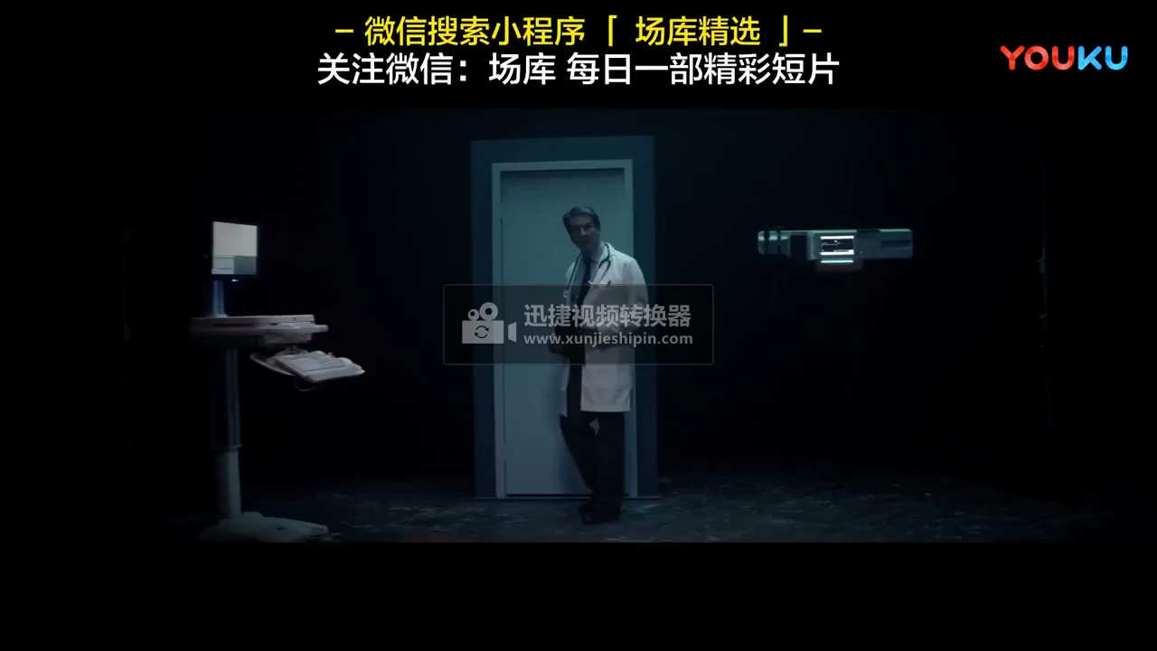
Let's see a promotional video about Down's syndrome
Maecenas porttitor congue massa. Fusce posuere, magna sed pulvinar ultricies, purus lectus malesuada libero

Slide 5

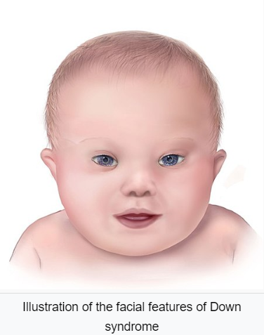
What is Down's syndrome?
Definition:
Down syndrome or Down's syndrome, also known as trisomy 21, is a genetic disorder caused by the presence of all or part of a third copy of chromosome 21.
It is usually associated with physical growth delays, mild to moderate intellectual disability, and characteristic facial features.
--wikipedai.org

Slide 6
Why we do research about Down's syndrome?
Current situation:
(1) Can not be cured
(2) Almost about screening and examination;
Little about therapeutic studies
--Searching on CNKI(2021.3.23): 7900 researches about DS, just 25 of them wrote about treatment

Slide 7
Why we do research about Down's syndrome?
Important research:
Loss of sorting nexin 27 contributes to excitatory synaptic dysfunction by modulating glutamate receptor recycling in Down's syndrome
--Nature Medicine

Slide 8
Summary
Analyzing the expression level of gene protein in mice with Down syndrome, based on logistic regression method to find out the proteins with greater influence, and to provide possible approaches for future treatment for Down syndrome.
Maecenas porttitor congue massa. Fusce posuere, magna sed pulvinar ultricies, purus lectus malesuada libero

Slide 9
Research Logic
Some proteins can influnce the intelligence of mice with DS.
Find the data about the expersion level of protein gene in mice
Find the proteins by using Logistic Regression.
Use in future medical treatment

Slide 10
Comparing with other researches
Different:
Medical technology -- Machine learning(Logistic regression)
Unsupervised learning -- Supervised learning

Slide 11
2.
Data Analysis

Slide 12

Data Collection
Resource: https://archive.ics.uci.edu/ml
Name: Mice Protein Expression Data Set
Basic information:
Total of 1080 measurements
8 classes
Expression levels of 77 proteins
2 genotypes (control or trisomy)
Figure. Resource webiste: UCI, Machine Learning Repository

Slide 13
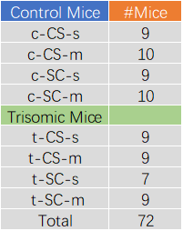
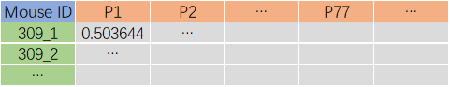
Data Collection
(b)
Figure. (a) is the 8 specific classes and corresponding numbers of experimental mice. (b) is the basic structure of the dataframe.
（a）
Note:
We will focus on the relationship between the genotype and the expression level of the protein encoded by the gene.

Slide 14
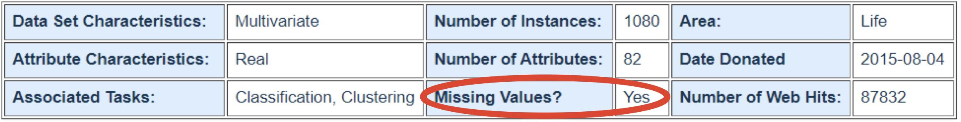
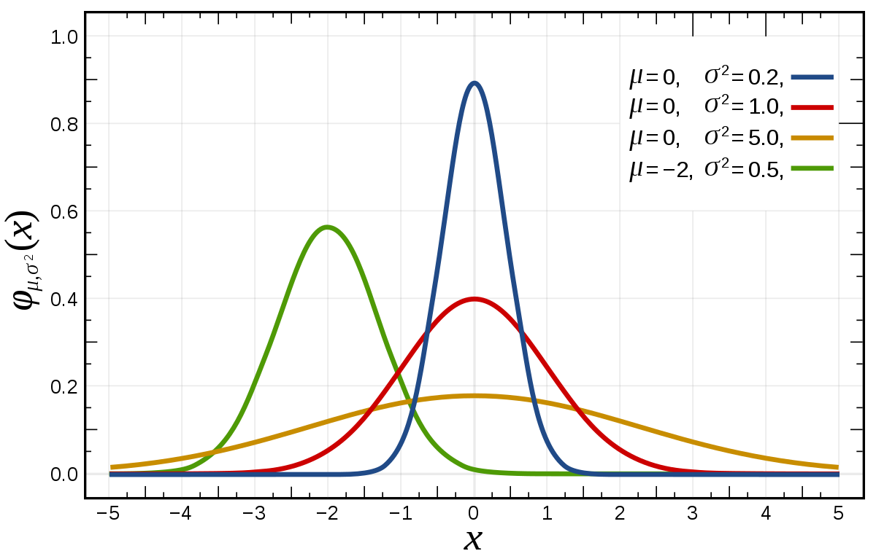
Data Processing
Figure. Description of Mice Protein Expression Data Set
The missing data that do exist need to be completed！
How?
Fill in the missing values in each column with the average of the non-missing values in that column.
Preprocessing:
Standardization, or mean removal and variance scaling.
In order to prevent poor performance of individual feature data.
Figure. Standard normal distribution (red curve)

Slide 15
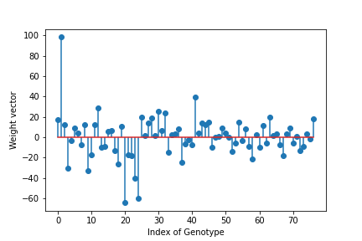
Logistic Regression
Procedure:
Import the standardized training features and corresponding labels for training.
Collect the weight vector from the logistic regression model.
Create a stem plot.
Find the two proteins most related to Down syndrome.
The two most invovled proteins are
ITSN1_N
and
BRAF_N
Figure. Weight vector for all 77 porteins

Slide 16
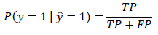
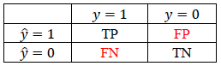
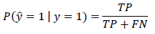
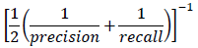
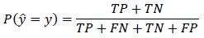
Cross Validation
Performance metrics for binary classification
In binary classification, there are 2 types of error:
False Positive
False Negative
Common Machine Learning performance metrics:
precision:
recall:
f1-score:
accurary:
The implications of these errors can be very different!
Table. Contingency table or confusion matrix

Slide 17
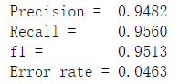
Cross Validation
Performance metrics for binary classification
After using 10-fold cross validation and getting help from sklearn to compute precision, recall, f1-score, and error rate, we have:
Table. Contingency table or confusion matrix

Slide 18
3.
Summary and Prospects

Slide 19
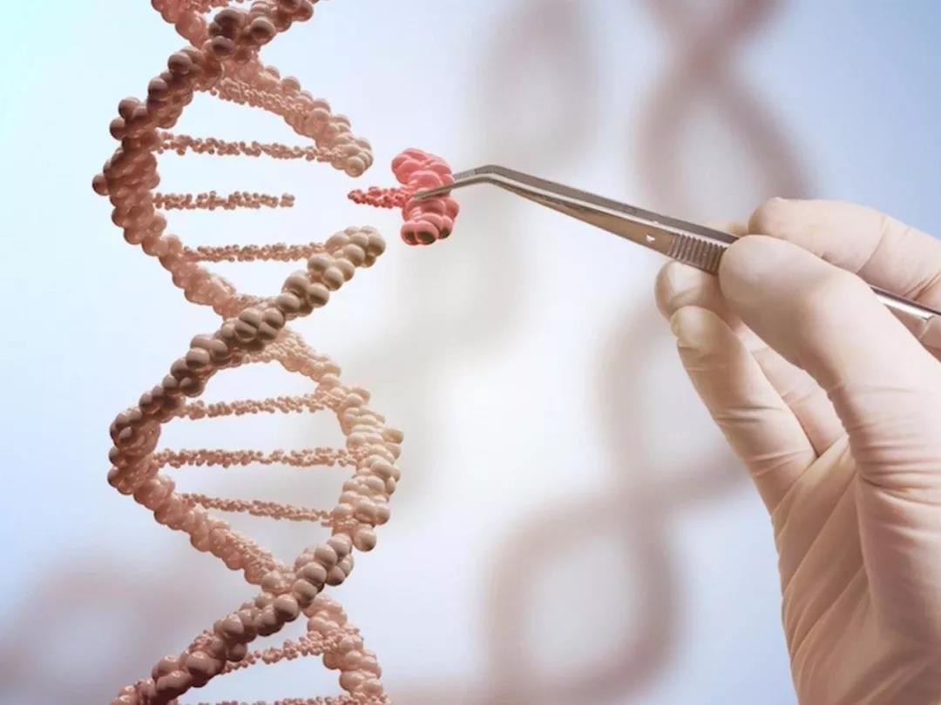
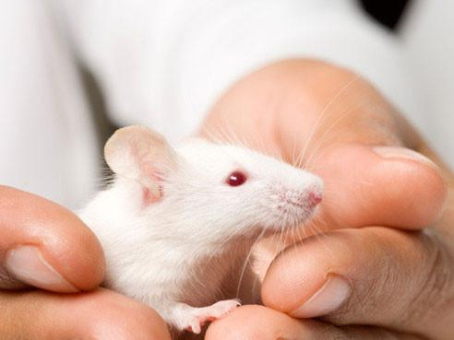
Summary
treatment method

Slide 20


Prospects
Apply to pets
Extend the life of pets
Increase the happiness of pet owners

Slide 21
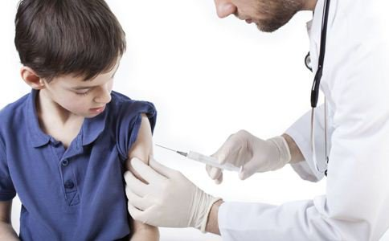




Prospects
Apply to humnan
Disease prevention
medical treatement

Slide 22
4.
References

Slide 23
References
[ 1 ]
The pictures of summary are from Baidu Pictures.
[ 2 ]
Higuera C, Gardiner KJ, Cios KJ (2015) Self-Organizing Feature Maps Identify Proteins Critical to Learning in a Mouse Model of Down Syndrome. PLoS ONE 10(6): e0129126.
[ 3 ]
Ahmed MM, Dhanasekaran AR, Block A, Tong S, Costa ACS, Stasko M, et al. (2015) Protein Dynamics Associated with Failed and Rescued Learning in the Ts65Dn Mouse Model of Down Syndrome.
[ 4 ]
wikipedai.org
Xiaofei Zhang Yangling Mu Yingjun Zhao Ying Zhou Xin Wang Hedieh Badie Li Shen Loo.(2013) Loss of sorting nexin 27 contributes to excitatory synaptic dysfunction by modulating glutamate receptor recycling in Down's syndrome. Nature medicine
[ 5 ]
[ 6 ]
CNKI.net

Slide 24
Thank you

